Slide 1

DBMS CAPSTONE
PROJECT REVIEW I
E-Commerce Marketplace Orders & Delivery Dashboard
DATE: 30/10/2026
CSA0504 • Database Management Systems
Presented by
Monish L – 1972260035
Prasannakumar S – 1924260253
S Hari Surendran – 1912260615
Guided by: Dr S Sankar, Professor

Slide 2


SECTION 01 • PROJECT OVERVIEW
Abstract
Abstract
Project snapshot
Online marketplaces generate orders, payments, deliveries and reviews faster than flat files can be analysed.
This project loads the nine Olist e-commerce CSV files into a normalized MySQL 8 database and builds ten parameterized SQL reports on it.
A Python app adds a Dataset Manager, Database Explorer, ER diagram, SQL Query Explorer, filters, drill-down, charts and CSV, Excel and PDF export.
The result is a verified dataset-to-dashboard pipeline that shows where and when deliveries slip.
Domain: E-commerce orders and delivery
Dataset: Olist, Kaggle (9 CSV files)
Database: MySQL 8, 9 normalized tables
Reports: 10 SQL-driven, with filters
App: Python web dashboard
Team: 3 modules – data, SQL, UI
CSA0504 • Database Management Systems | E-Commerce Marketplace Orders & Delivery Dashboard
02

Slide 3
SECTION 01 • PROJECT OVERVIEW
Introduction and Project Objectives
Project context
Measurable objectives
• Olist links Brazilian sellers to customers; each order creates linked order, payment, delivery and review records
• Delivery delays and revenue patterns need joins across customers, orders, items, products and sellers
• Users: marketplace operations and logistics analysts
• Scope: analytics on historical data, not a live order-processing engine
• To examine, clean and import the 9 Olist CSV files with a repeatable script
• To design a normalized (3NF) MySQL 8 schema with PK, FK and constraints
• To write parameterized SQL: joins, grouping, subqueries, views, window functions
• To build a Python app with Dataset Manager, Database Explorer and SQL Query Explorer
• To present 10 interactive reports with filters, drill-down and CSV / Excel / PDF export
CSA0504 • Database Management Systems | E-Commerce Marketplace Orders & Delivery Dashboard
03

Slide 4
SECTION 01 • PROJECT OVERVIEW
Problem Identification and Analysis
Problem statement
Problem evidence and scope
Questions to answer
1. Which states and product categories drive orders and revenue?
2. How long do deliveries take, and where do they run later than estimated?
3. Do late deliveries go with lower review scores?
Why raw CSV is not enough: nine linked files, no enforced keys, a 1,000,163-row geolocation file; joins by hand in Excel are slow and error-prone.
Stakeholder: marketplace operations / logistics manager.
• Issues: repeated zip-prefix rows, repeated review_id values, NULL delivery dates for undelivered orders, product category names in Portuguese
• Measures: 9 files, about 1.55 million rows in total (orders 99,441; order items 112,650; payments 103,886)
• Period: orders placed 2016–2018, so time-series reports are valid
Will NOT implement: checkout, payments, user login, real-time order processing, or predictive models.
CSA0504 • Database Management Systems | E-Commerce Marketplace Orders & Delivery Dashboard
04

Slide 5
SECTION 02 • DATASET AND DATABASE DESIGN
Dataset Source and Data Dictionary
Dataset metadata
Data dictionary (key attributes)
Dataset: Brazilian E-Commerce Public Dataset by Olist
Source: Kaggle (olistbr)
URL: kaggle.com/datasets/olistbr/brazilian-ecommerce
Format: 9 CSV files
Rows × columns: orders 99,441 × 8; order_items 112,650 × 7; customers 99,441 × 5; geolocation 1,000,163 × 5
Period: orders placed 2016–2018
Missing / duplicate: delivery dates NULL for undelivered orders; geolocation repeats zip prefixes; counts from import report
License: CC BY-NC-SA 4.0 (Kaggle page)
ATTRIBUTE | TYPE | MEANING
order_id | VARCHAR(32) | Unique order identifier
order_status | VARCHAR(20) | delivered, shipped, canceled…
order_purchase_timestamp | DATETIME | When the customer ordered
order_delivered_customer_date | DATETIME | Actual delivery (may be NULL)
order_estimated_delivery_date | DATETIME | Promised delivery date
price / freight_value | DECIMAL(10,2) | Item price / shipping cost
payment_type | VARCHAR(20) | Credit card, boleto, voucher…
review_score | TINYINT | Customer rating, 1 to 5
customer_state | CHAR(2) | Brazilian state code
CSA0504 • Database Management Systems | E-Commerce Marketplace Orders & Delivery Dashboard
05

Slide 6
SECTION 02 • DATASET AND DATABASE DESIGN
System Architecture
Olist CSVs
9 files
Clean + Import
pandas script
MySQL 8
3NF tables
SQL Layer
queries + views
Python App
charts + export
→
→
→
→
Architecture description
A Python import script reads each CSV, converts types, turns blanks into NULL and loads the nine tables in foreign-key order. The Python web app connects through mysql-connector; filters become query parameters (no string concatenation). Results go to Plotly charts and tables and can be exported to CSV, Excel and PDF.
CSA0504 • Database Management Systems | E-Commerce Marketplace Orders & Delivery Dashboard
06

Slide 7
SECTION 02 • DATASET AND DATABASE DESIGN
Normalization and Functional Dependencies
Original schema and dependency analysis
Normalization steps
Flattened view: order, customer, item, product, seller, payment and review columns in one row
Candidate key: (order_id, order_item_id)
Functional dependencies
order_id → customer_id, status, timestamps
customer_id → customer_unique_id, zip_prefix
zip_prefix → city, state, lat, lng
product_id → category_name, size, weight
category_name → category_name_en
(order_id, order_item_id) → product_id, seller_id, price, freight
Partial: order_id alone fixes order data
Transitive: customer_id → zip_prefix → city
1NF: atomic values, typed DATETIME columns; review_id repeats, so key is (review_id, order_id)
2NF: order data split from item data; payments and reviews get their own tables
3NF: city/state move to geolocation; category names move to product_categories
Final tables: geolocation, customers, sellers, product_categories, products, orders, order_items, order_payments, order_reviews
Why valid: joins on the foreign keys rebuild the original rows, and no city or category text is stored twice
CSA0504 • Database Management Systems | E-Commerce Marketplace Orders & Delivery Dashboard
07

Slide 8
SECTION 02 • DATASET AND DATABASE DESIGN
ER Diagram and Relational Schema
geolocation
customers
orders
order_reviews
Relationships
PK zip_prefix
city, state
avg_lat, avg_lng
1
N
PK customer_id
customer_unique_id
FK zip_prefix
1
N
PK order_id
FK customer_id
order_status
5 date/time columns
1
N
PK,FK order_id
PK review_id
review_score
comment, dates
• geolocation 1:N customers
• geolocation 1:N sellers
• customers 1:N orders
• orders 1:N order_items
• orders 1:N order_payments
• orders 1:N order_reviews
• products 1:N order_items
• sellers 1:N order_items
• product_categories 1:N products
M:N orders ↔ products is resolved by the bridge table order_items
1
1
1
N
N
sellers
order_items
order_payments
PK seller_id
FK zip_prefix
1
N
PK,FK order_id
PK order_item_id
FK product_id
FK seller_id
price, freight_value
N
PK,FK order_id
PK payment_sequential
payment_type
installments, value
N
1
product_categories
products
Legend
PK category_name
category_name_en
1
N
PK product_id
FK category_name
weight, 3 dimensions
photos_qty
PK primary key
FK foreign key
1 / N one-to-many
CSA0504 • Database Management Systems | E-Commerce Marketplace Orders & Delivery Dashboard
08

Slide 9
SECTION 02 • DATASET AND DATABASE DESIGN
MySQL Implementation
Table: orders (DDL summary)
Import validation and SQL DDL
Column | Data type | Constraint
order_id | VARCHAR(32) | PRIMARY KEY
customer_id | VARCHAR(32) | NOT NULL, FOREIGN KEY
order_status | VARCHAR(20) | NOT NULL
order_purchase_timestamp | DATETIME | NOT NULL
order_approved_at | DATETIME | NULL allowed
order_delivered_customer_date | DATETIME | NULL allowed
order_estimated_delivery_date | DATETIME | NOT NULL
• 9 normalized tables, 9 foreign keys
• Source rows to load: orders 99,441; items 112,650; payments 103,886; products 32,951; sellers 3,095
• Constraints: PK on every table; FK for each relationship; UNIQUE category_name_en; CHECK review_score 1–5, price ≥ 0
• Dirty data: blank strings → NULL, text → DATETIME/DECIMAL; zip prefixes missing from geolocation get stub rows so FKs hold
• Sample: SELECT order_status, COUNT(*) FROM orders GROUP BY order_status;
CSA0504 • Database Management Systems | E-Commerce Marketplace Orders & Delivery Dashboard
09

Slide 10
SECTION 03 • IMPLEMENTATION
Tools, Technologies and Environment
Database
Language
MySQL 8.0 • MySQL Workbench
Python 3.11 • pandas • mysql-connector-python
UI framework
Charts
Streamlit web app (Python)
Plotly – interactive charts and drill-down
Import & Export
Setup
CSV import script • export: CSV, Excel (openpyxl), PDF (ReportLab)
Antigravity IDE • Git • .env • requirements.txt • pytest
CSA0504 • Database Management Systems | E-Commerce Marketplace Orders & Delivery Dashboard
10

Slide 11
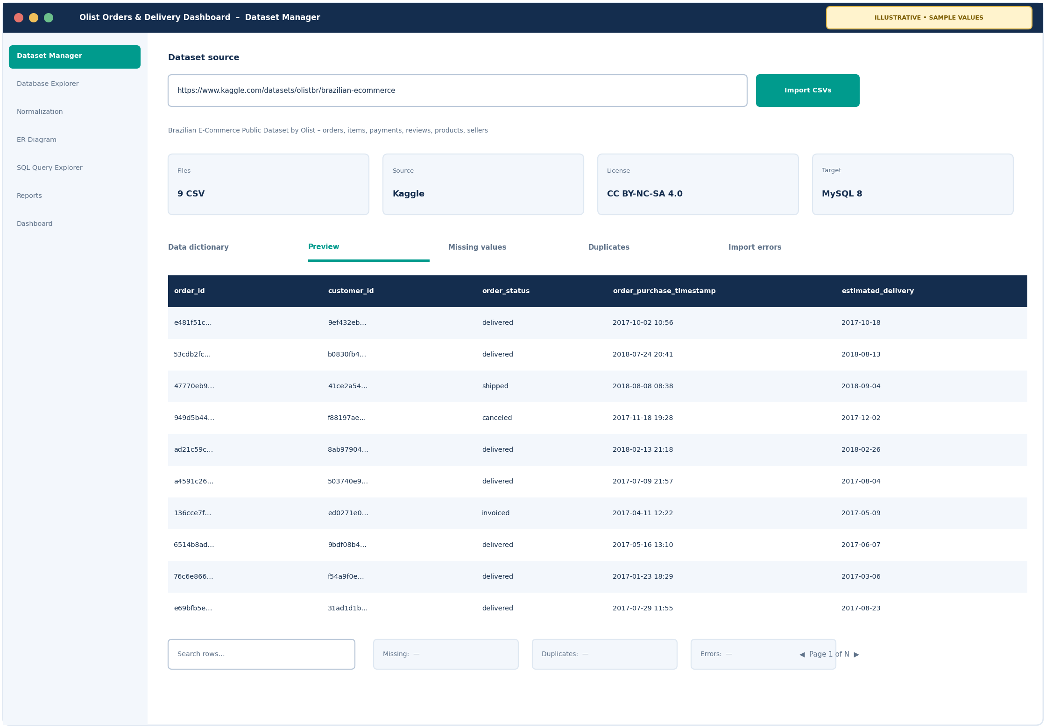
SECTION 03 • INDIVIDUAL MODULES
Module 1 — Dataset Manager + Database Design
Module owner: Monish L, 1972260035 | Design, implementation and testing of this module.
Describe actual functionality
• Dataset URL, description and purpose on the Dataset Manager page
• Import of the 9 original CSV files with cleaning (NULLs, types)
• Data dictionary: type, meaning, missing values, examples
• Validation summary: missing values, duplicates, import errors
• Functional dependencies, 1NF–3NF, ER model and 3NF tables
• PK, FK, UNIQUE, CHECK constraints; reproducible import script; master-data page
CSA0504 • Database Management Systems | E-Commerce Marketplace Orders & Delivery Dashboard
11

Slide 12
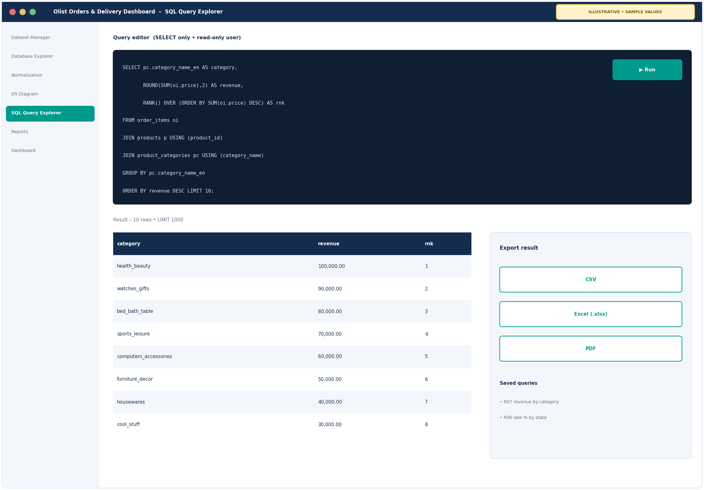
SECTION 03 • INDIVIDUAL MODULES
Module 2 — SQL Query and Report Engine
Module owner: Prasannakumar S, 1924260253 | Design, implementation and testing of this module.
Describe actual functionality
• Parameterized SQL for each of the 10 dashboard reports
• Joins across orders, items, products, customers and sellers
• Grouped summaries with HAVING; subqueries and CASE
• Views and window functions (RANK, running totals)
• Query validation: SQL totals compared with dashboard totals
• Saved queries, report APIs and report tables; SQL Query Explorer backend
CSA0504 • Database Management Systems | E-Commerce Marketplace Orders & Delivery Dashboard
12

Slide 13
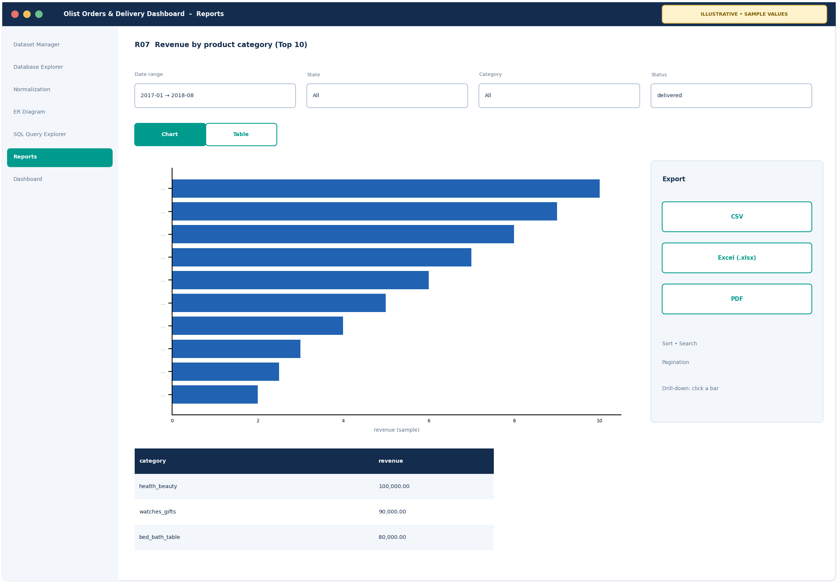
SECTION 03 • INDIVIDUAL MODULES
Module 3 — Application + Dashboard
Module owner: S Hari Surendran, 1912260615 | Design, implementation and testing of this module.
Describe actual functionality
• Python application connected to MySQL
• Database Explorer: tables, columns, keys, records, search, sort, pagination
• 10 report widgets with filters and drill-down
• Chart / table switching for every report
• Export of report results to CSV, Excel and PDF
• ER diagram page with zoom and PNG/PDF export
CSA0504 • Database Management Systems | E-Commerce Marketplace Orders & Delivery Dashboard
13

Slide 14
SECTION 03 • IMPLEMENTATION
Module Integration and Workflow
Dataset Manager
(Module 1)
3NF MySQL
Tables (Module 1)
SQL Reports
Engine (Module 2)
Dashboard +
Exports (Module 3)
→
→
→
Integration evidence
1. Import the Olist CSV files and populate the 9 tables (foreign keys checked).
2. Run report R07, revenue by product category: a three-table join with GROUP BY and a Top-10 limit.
3. Show the result as a bar chart, then switch the same data to a table.
4. Export the table to CSV and confirm the row count and total match the SQL result.
CSA0504 • Database Management Systems | E-Commerce Marketplace Orders & Delivery Dashboard
14

Slide 15
SECTION 03 • IMPLEMENTATION
Feature Coverage and Ownership
Application features
Owner and evidence
• Dataset Manager: URL, description, import, data dictionary, validation summary
• Database Explorer: tables, columns, keys, records, relationships
• Normalization: dependencies, 1NF–3NF, resulting tables
• ER Diagram: keys, cardinalities, zoom, PNG/PDF export
• SQL Query Explorer: custom editor and result grid
• Reports: 10 tables with filters, sort, search, pagination
• Dashboard: 10 charts, KPI cards, drill-down
Module 1 – Monish L: Dataset Manager, normalization, ER model and schema
Module 2 – Prasannakumar S: SQL Query Explorer, report queries, views and report APIs
Module 3 – S Hari Surendran: Database Explorer, ER diagram page, report and dashboard UI, exports
CSA0504 • Database Management Systems | E-Commerce Marketplace Orders & Delivery Dashboard
15

Slide 16
SECTION 04 • RESULTS AND VALIDATION
SQL Queries and Actual Outputs
Query A: JOIN (R07)
Query B: HAVING (R06)
Query C: Subquery (R09)
SELECT pc.category_name_en AS category,
ROUND(SUM(oi.price),2) AS revenue
FROM order_items oi
JOIN products p USING (product_id)
JOIN product_categories pc
USING (category_name)
GROUP BY pc.category_name_en
ORDER BY revenue DESC LIMIT 10;
Shows: top 10 categories by revenue.
SELECT g.state, COUNT(*) AS delivered,
ROUND(100*SUM(
o.order_delivered_customer_date >
o.order_estimated_delivery_date)
/COUNT(*),1) AS late_pct
FROM orders o
JOIN customers c USING (customer_id)
JOIN geolocation g USING (zip_prefix)
WHERE o.order_status='delivered'
GROUP BY g.state
HAVING COUNT(*) >= 500
ORDER BY late_pct DESC;
Shows: states with the most late deliveries.
CREATE VIEW v_delivery_days AS
SELECT order_id, DATEDIFF(
order_delivered_customer_date,
order_purchase_timestamp) AS days
FROM orders
WHERE order_delivered_customer_date
IS NOT NULL;
SELECT COUNT(*) FROM v_delivery_days
WHERE days > (SELECT AVG(days)
FROM v_delivery_days);
Shows: orders slower than average.
CSA0504 • Database Management Systems | E-Commerce Marketplace Orders & Delivery Dashboard
16

Slide 17
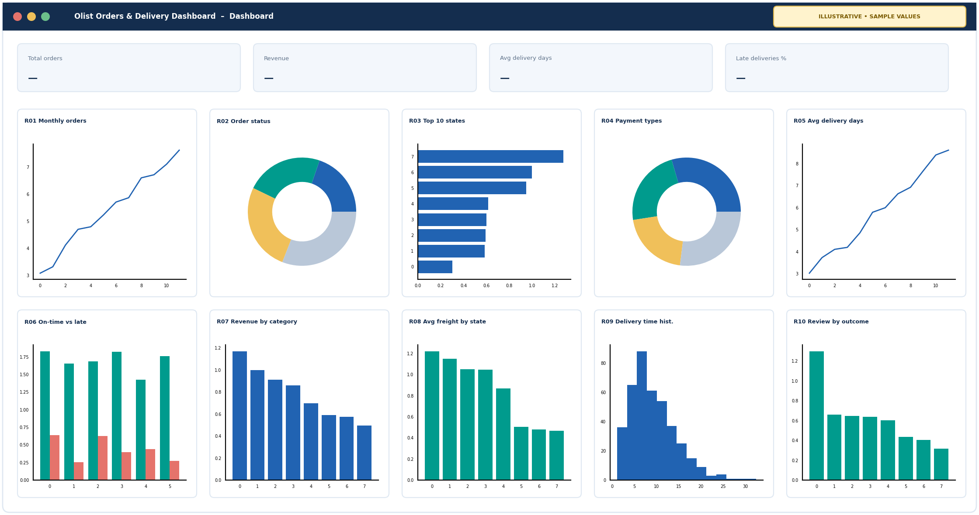
SECTION 04 • RESULTS AND VALIDATION
Dashboard — Ten Mandatory Visualizations
Report coverage
R01 Monthly orders – Line
R02 Order status share – Donut
R03 Top 10 states by orders – Horizontal bar
R04 Payment type share – Donut
R05 Avg delivery days by month – Line
R06 On-time vs late by state – Grouped bar
R07 Revenue, top 10 categories – Bar
R08 Avg freight value by state – Column
R09 Delivery-time distribution – Histogram
R10 Avg review score by delivery outcome – Bar
CSA0504 • Database Management Systems | E-Commerce Marketplace Orders & Delivery Dashboard
17

Slide 18
SECTION 04 • RESULTS AND VALIDATION
Report Exports and Testing
Test cases and evidence
Test result summary
• Import: row count of each table equals its source CSV
• Constraints: an order for a missing customer is rejected
• Totals: SQL result = dashboard KPI = exported file
• Filters: date, state, category and status return only matching rows
• Exports: CSV, Excel and PDF files open and match the table
• Empty results and pagination show a clear message
Function | Check | Status
Dataset import | Row counts match CSV | [Pass / Fail]
PK / FK constraints | Orphan insert rejected | [Pass / Fail]
10 report queries | SQL totals = dashboard | [Pass / Fail]
Dashboard refresh | Filters update charts | [Pass / Fail]
Exports | CSV, XLSX, PDF match | [Pass / Fail]
CSA0504 • Database Management Systems | E-Commerce Marketplace Orders & Delivery Dashboard
18

Slide 19
SECTION 04 • RESULTS AND VALIDATION
Results and Discussion
Results achieved
Key findings and limits
• 9 source CSV files loaded into 9 normalized tables
• 10 SQL reports, each backed by its own query
• 10 interactive visualizations plus KPI cards
• Filters on date, state, category and order status
• Exports to CSV, Excel and PDF
Finding 1 (R03): [share of orders from the top state]
Finding 2 (R05, R06): [avg delivery days; late %]
Finding 3 (R10): [average review score, on-time vs late]
Limits: historical 2016–2018 sample; delivery dates are NULL for undelivered orders; results describe this marketplace only.
CSA0504 • Database Management Systems | E-Commerce Marketplace Orders & Delivery Dashboard
19

Slide 20
SECTION 05 • REFLECTION
Individual Contributions and Learning
Monish L
Prasannakumar S
S Hari Surendran
Reg. No.: 1972260035
Assigned: Module 1 – Relational model and dataset import
Implemented: dataset review, cleaning, import script, ER model, 3NF tables, constraints, master-data page
DBMS learning: functional dependencies, 1NF–3NF, PK/FK design
Challenge: repeated zip prefixes and review_id values needed a one-row-per-zip table and a composite review key
Reg. No.: 1924260253
Assigned: Module 2 – SQL analytics and report engine
Implemented: 10 parameterized report queries, views, query validation, saved queries, report APIs
DBMS learning: joins, GROUP BY / HAVING, subqueries, window functions
Challenge: keeping filters safe and SQL results equal to dashboard totals
Reg. No.: 1912260615
Assigned: Module 3 – Application UI and dashboard
Implemented: Python app, 10 report widgets, filters, drill-down, chart/table switch, CSV export
DBMS learning: application-to-MySQL access, query parameters, pagination
Challenge: one result set must drive the chart, table and export so they agree
CSA0504 • Database Management Systems | E-Commerce Marketplace Orders & Delivery Dashboard
20

Slide 21
SECTION 05 • REFLECTION
Conclusion and Future Enhancements
Conclusion
Future enhancements
• Problem: slow, fragmented analysis of marketplace orders and deliveries
• Pipeline: Olist CSV → MySQL → SQL → dashboard
• Normalized 3NF database with PK, FK and CHECK constraints
• 10 SQL reports with filters, charts and CSV / Excel / PDF export
• Results traceable to SQL; limits: historical sample, NULL delivery dates, association only
• Order-level and seller-level drill-downs
• Stronger import validation and error reports
• Add other open Olist datasets, such as the marketing funnel
• Report scheduling and saved filters
• Role-specific views for operations and sellers
CSA0504 • Database Management Systems | E-Commerce Marketplace Orders & Delivery Dashboard
21

Slide 22
SECTION 05 • REFLECTION
References and Dataset Credits
Sources for the data, database and tools used.
Olist. Brazilian E-Commerce Public Dataset by Olist. Kaggle. https://www.kaggle.com/datasets/olistbr/brazilian-ecommerce (accessed October 2026)
Dataset documentation and column descriptions: the dataset page on Kaggle (link above), including the license.
MySQL 8.0 Reference Manual. https://dev.mysql.com/doc/refman/8.0/en/
Python tools: pandas, Flask, Plotly documentation.
Normalization method: Silberschatz, Korth and Sudarshan, Database System Concepts (1NF–3NF decomposition).
CSA0504 • Database Management Systems | E-Commerce Marketplace Orders & Delivery Dashboard
22

Slide 23
THANK YOU
Questions & Discussion
E-Commerce Marketplace Orders & Delivery Dashboard • CSA0504

